Slide 1
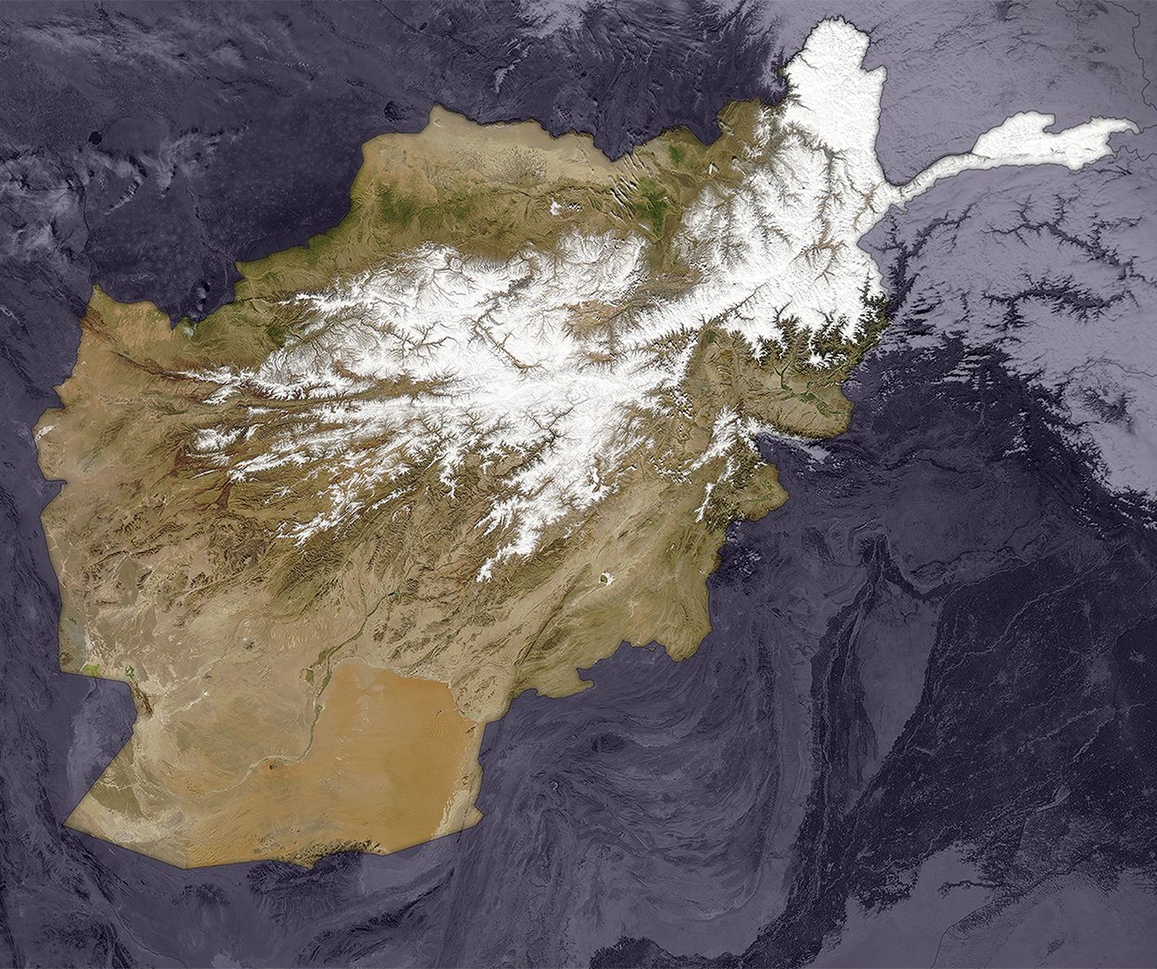
Afghanistan
A dense pack of snow and ice covers the rugged, mountainous landscape of Afghanistan in this image captured by the MODIS instrument on NASA’s Terra satellite in February, 2006.
Satellite images are an important tool used to measure snowfall; snow melt from the mountains is an important source of the country’s fresh water supply.
https://visibleearth.nasa.gov
https://eol.jsc.nasa.gov
Notes:
To customize your postcard:
Visit https://visibleearth.nasa.gov or https://eol.jsc.nasa.gov to select and download an image to your desktop.
To change the color of objects—including “Postcards from the Edge of Space” text, icons and boxes—use the “Shape Fill” menu on your home page to select a fill color.
To edit text, click the Title or Body text and replace. Choose a font color by going to the ‘Home’ tab under the ‘Font’ subsection and select the color.*
To replace image, click on the current image and delete it. Go to ”Insert/Picture/Picture from File” and select the image from your desktop. Then click on the image and select ‘Insert’. Then right click (option click on Mac) and select ‘Send to Back.’ Scale by grabbing the corner marker and dragging the image until the space if filled. To note – excess image outside the page border will not print.
*The NASA logo and website are not meant to be altered.

Slide 2
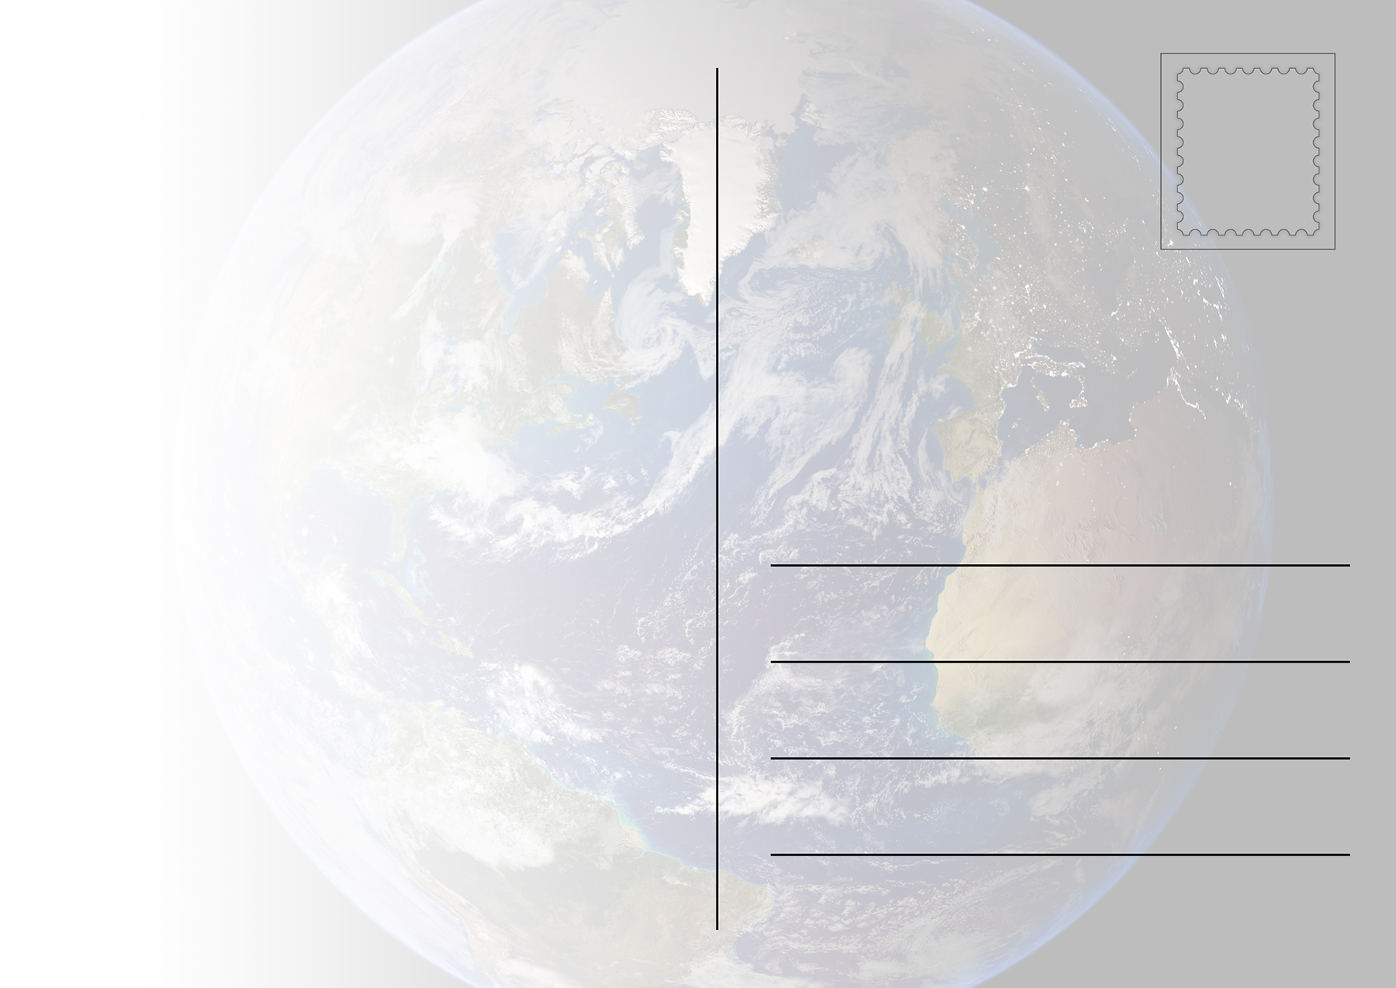
Greetings from Afghanistan,
Write your greeting here.
Notes:
To customize your postcard:
Click on the greeting text to replace, or delete text and print blank to write in text.

